Slide 1

Advanced Topics in Networking: Special Topics in Internet of Things
Ambuj Varshney
Assistant Professor, National University of Singapore
Wireless, Embedded Intelligence, Sensing, and Emerging Technologies Group
ambujv@nus.edu.sg, http://ambuj.se
Notes:
++ Thank you for inviting me to give this talk
++ In this talk, I will present a pathway that can enable us to make wireless embedded systems ubiquitous. I will describe my previous research efforts that tackle the critical challenges that limit the growth of wireless embedded systems. These are related to the growing energy asymmetry that exists between sensing, computation and communication blocks on these platforms.
++ Finally, I will conclude my talk by covering the research agenda that I would like to work on as a faculty member.

Slide 2
Lecture 3: Wireless Communication for Internet of Things
Notes:
++ Over the past few years, I have designed several backscatter and beyond backscatter systems that precisely overcome these critical challenges that have limited the widespread deployment of backscatter on IoT devices.
++ The research vision that I have pursued and would like to pursue as a faculty member is to enable a massive deployment of IoT devices by bridging the energy asymmetry between sensing, computation and communication blocks by designing novel platforms and communication mechanisms. I am going to describe some of my research contributions next.

Slide 3
Learning objectives for today’s lecture
Major components and tasks of internet of things
History of wireless, and basics of radio waves and communication
Short range wireless standards for Internet of Things
Case study: Backscattering Bluetooth/WiFi compatible signals
Notes:
Why do the IoT platforms suffer from this energy challenge? To understand this, we investigate the architecture of the IoT device. We show this architecture in the figure on the slide. It consists of a series of stages that enable us to sense physical phenomena, process and transmit the sensor information through a transceiver such as ZigBee/BLE/LoRa.
This architecture has remained unchanged over the past two decades. We find that during this time, sensors have become exceeding efficient. Today, we find sensors such as an accelerometer or a temperature sensor consumes just a few tens of microwatts of power consumption. However, we find that rest of the architecture components that are shown in red colour remain significantly energy expensive. To understand the reason for this significant energy asymmetry, we look at the following slide.

Slide 4
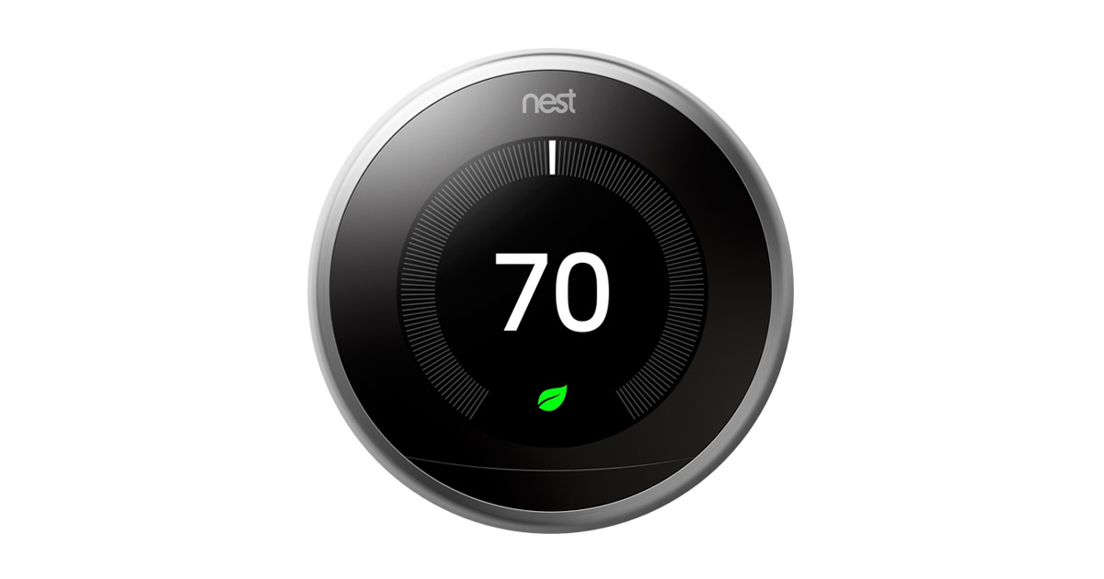
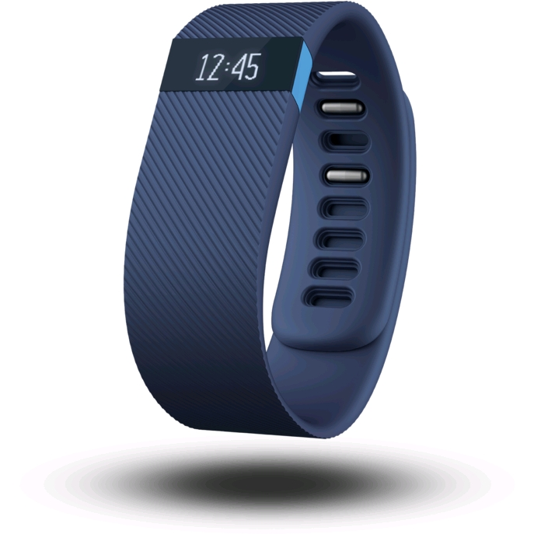
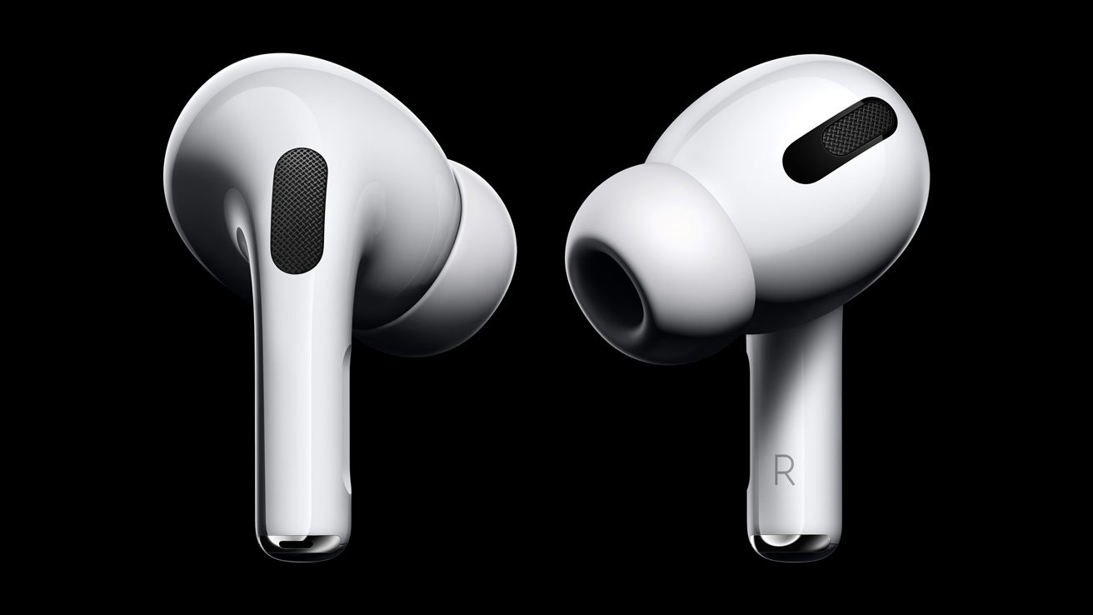
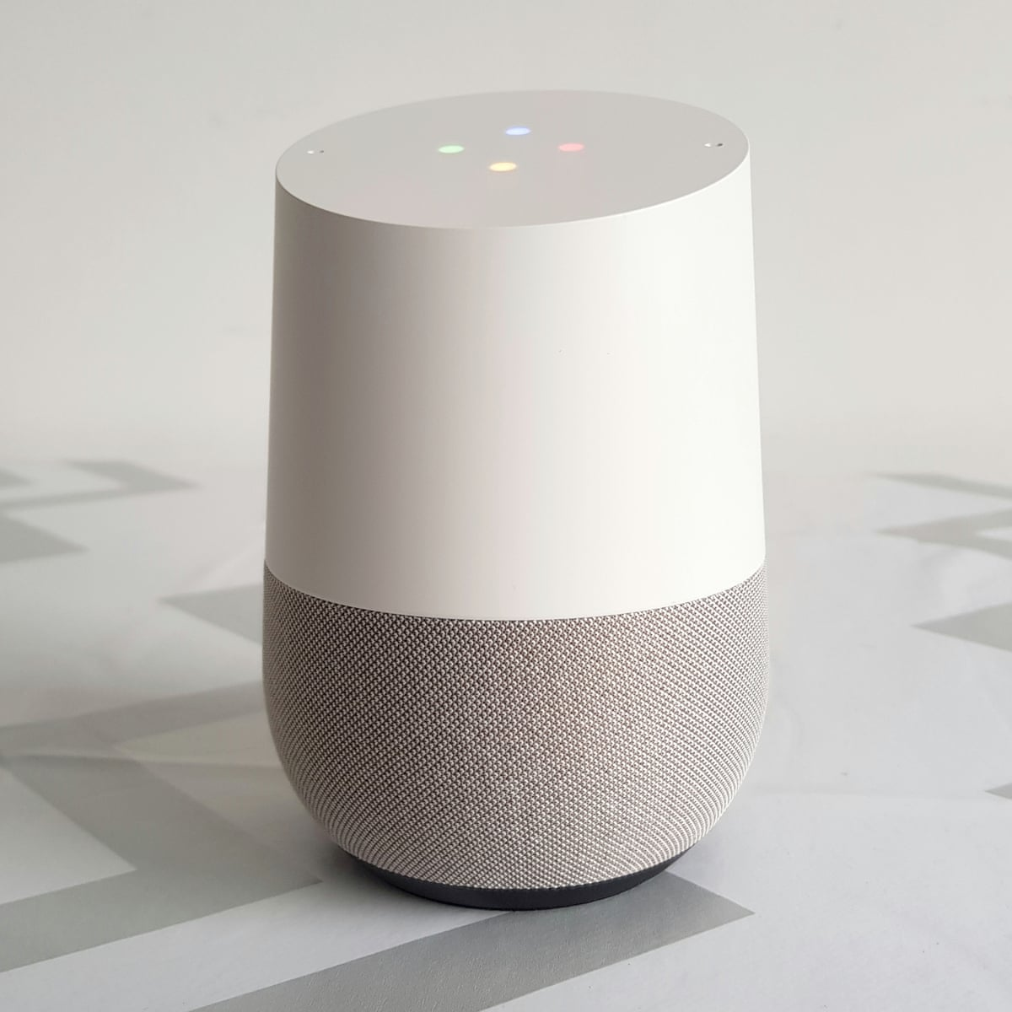
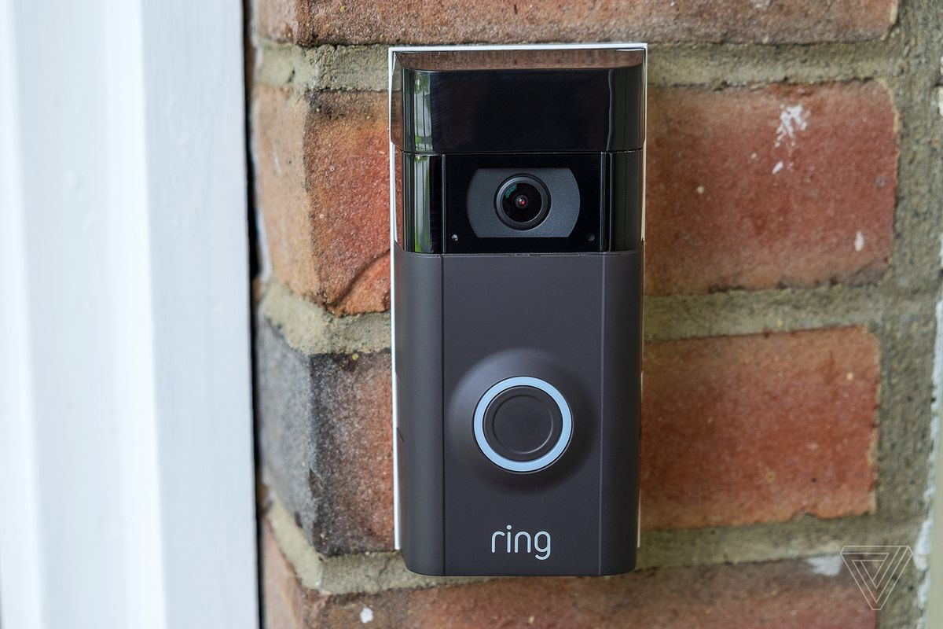
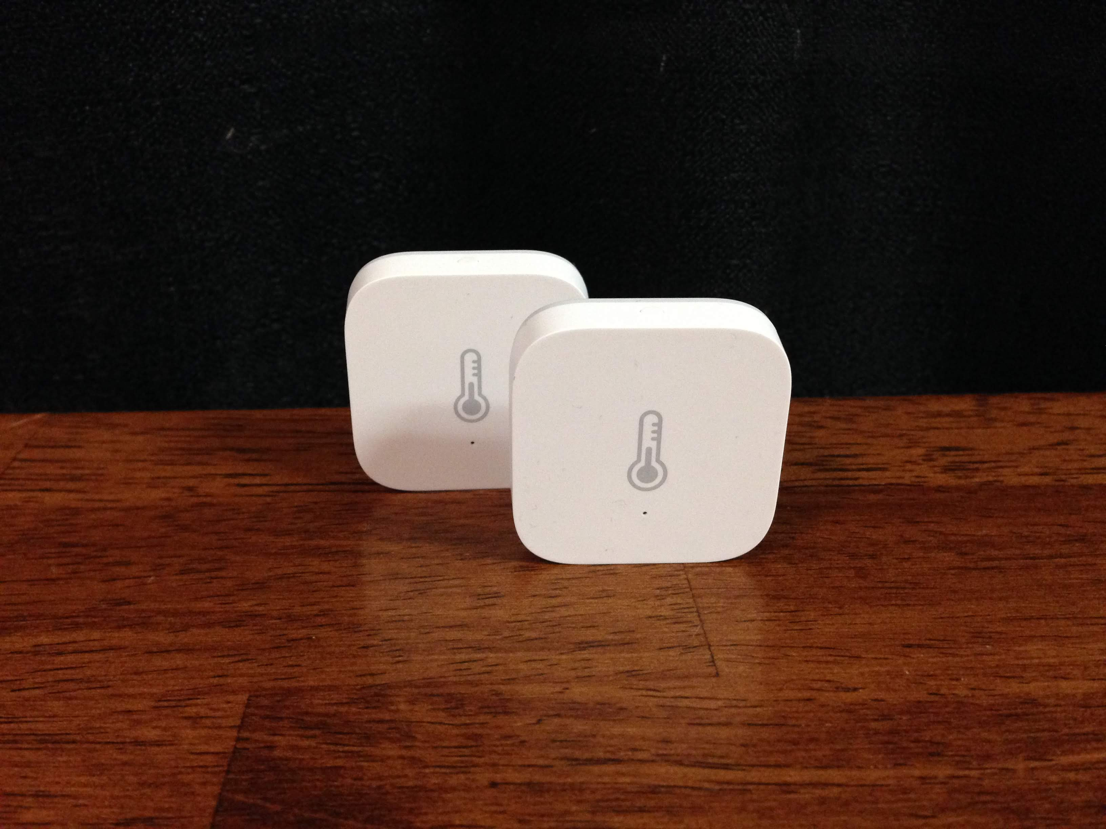
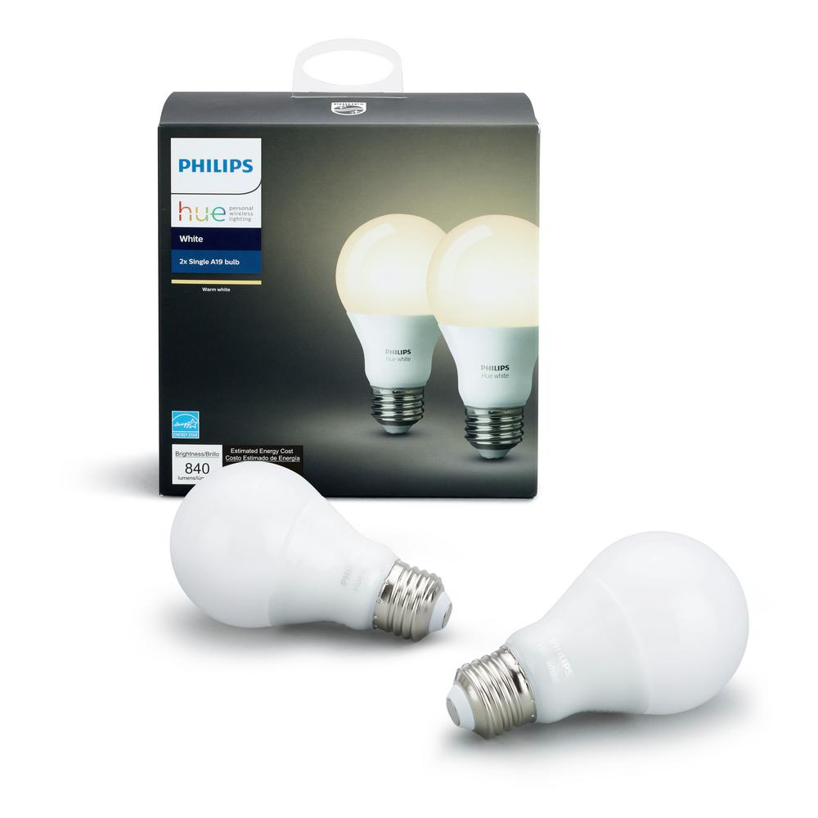
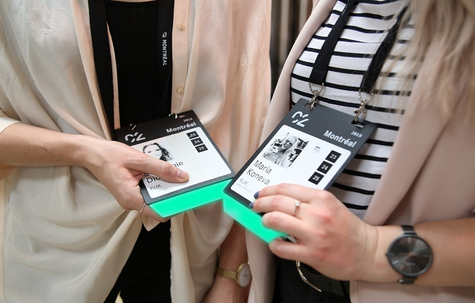
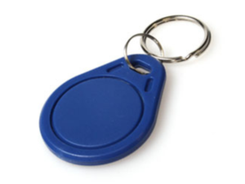
Internet of things are all around us...
Google nest thermostat
Fitbit activity tracker
Apple airpods
Smart speaker
Ring doorbell
Xiaomi temperature sensor
Philips hue smart bulb
Smart badges
BLE proximity beacon
Notes:
+ I begin this presentation by demonstrating devices that we interact with within our daily lives. These include Fitbit, AirPods, smart speakers or ble proximity beacons that we attach to objects such as keychain to keep track of them. All of these are examples of wireless embedded systems.

Slide 5
Internet of things are all around us... are wireless
Google nest thermostat
Fitbit activity tracker
Apple airpods
Smart speaker
Ring doorbell
Xiaomi temperature sensor
Philips hue smart bulb
Smart badges
BLE proximity beacon
Notes:
+ I begin this presentation by demonstrating devices that we interact with within our daily lives. These include Fitbit, AirPods, smart speakers or ble proximity beacons that we attach to objects such as keychain to keep track of them. All of these are examples of wireless embedded systems.

Slide 6
Device Architecture of Wireless Embedded Systems
Notes:
++ Over the past few years, I have designed several backscatter and beyond backscatter systems that precisely overcome these critical challenges that have limited the widespread deployment of backscatter on IoT devices.
++ The research vision that I have pursued and would like to pursue as a faculty member is to enable a massive deployment of IoT devices by bridging the energy asymmetry between sensing, computation and communication blocks by designing novel platforms and communication mechanisms. I am going to describe some of my research contributions next.

Slide 7
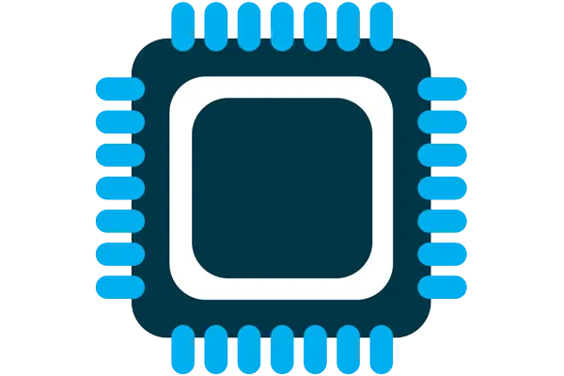



Four major components of IoT device
Computation and Storage
Sensing and Actuation
Power
Wireless Connectivity
Notes:
First, we look at the computational elements, and these consist of a microcontroller or an FPGA. Today, we find that these computational elements consume at least one order of magnitude higher power consumption when compared to the commonly used sensors.
However, we also find that microcontrollers are increasingly becoming energy efficient. We investigate a typical microcontroller that has been used in sensor platforms over the past two decades. We find that energy efficiency has improved by almost two orders of magnitude. Some of the present-generation microcontrollers, such as Ambiq Apollo4 consume just 3 uA/MHz than 330 uA for MSP430 used on platforms such as TelOS B.
If the trend continues, we can expect the microcontrollers to catch up with the sensors and become energy-efficient. This significant improvement is that the digital components are increasing becoming efficient as they follow moore’s law.

Slide 8
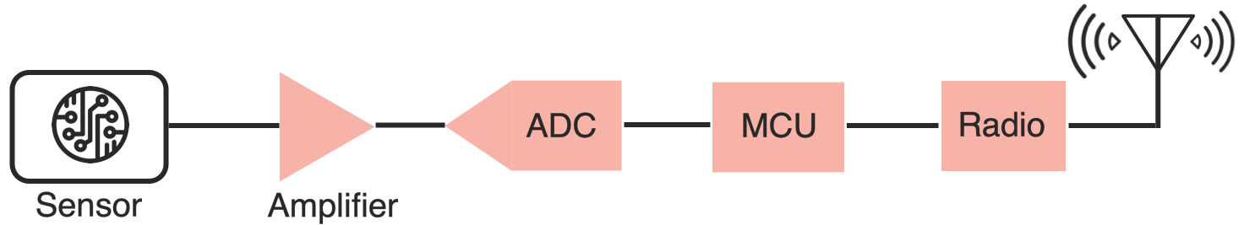
Sensing, Computing and Wireless Communication
IoT device performs (primarily) three tasks: Sensing, Computing and Wireless Communication
Notes:
First, we look at the computational elements, and these consist of a microcontroller or an FPGA. Today, we find that these computational elements consume at least one order of magnitude higher power consumption when compared to the commonly used sensors.
However, we also find that microcontrollers are increasingly becoming energy efficient. We investigate a typical microcontroller that has been used in sensor platforms over the past two decades. We find that energy efficiency has improved by almost two orders of magnitude. Some of the present-generation microcontrollers, such as Ambiq Apollo4 consume just 3 uA/MHz than 330 uA for MSP430 used on platforms such as TelOS B.
If the trend continues, we can expect the microcontrollers to catch up with the sensors and become energy-efficient. This significant improvement is that the digital components are increasing becoming efficient as they follow moore’s law.

Slide 9
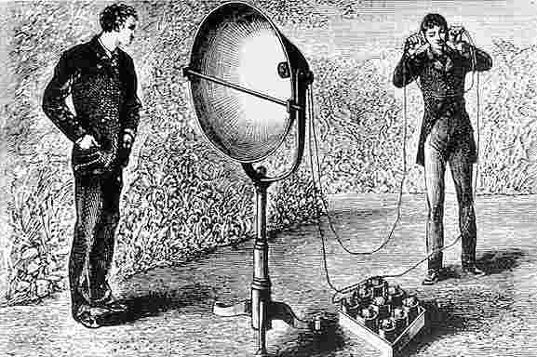
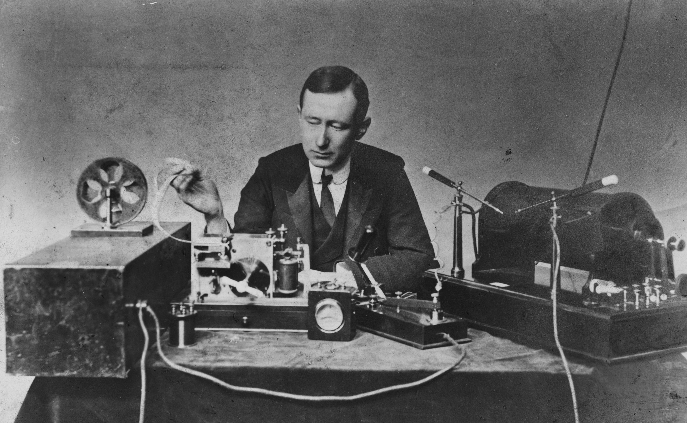
History of Wireless Transmissions
Notes:
First, we look at the computational elements, and these consist of a microcontroller or an FPGA. Today, we find that these computational elements consume at least one order of magnitude higher power consumption when compared to the commonly used sensors.
However, we also find that microcontrollers are increasingly becoming energy efficient. We investigate a typical microcontroller that has been used in sensor platforms over the past two decades. We find that energy efficiency has improved by almost two orders of magnitude. Some of the present-generation microcontrollers, such as Ambiq Apollo4 consume just 3 uA/MHz than 330 uA for MSP430 used on platforms such as TelOS B.
If the trend continues, we can expect the microcontrollers to catch up with the sensors and become energy-efficient. This significant improvement is that the digital components are increasing becoming efficient as they follow moore’s law.

Slide 10
Wireless is ubiquitous. Let’s look at basics
Notes:
++ Over the past few years, I have designed several backscatter and beyond backscatter systems that precisely overcome these critical challenges that have limited the widespread deployment of backscatter on IoT devices.
++ The research vision that I have pursued and would like to pursue as a faculty member is to enable a massive deployment of IoT devices by bridging the energy asymmetry between sensing, computation and communication blocks by designing novel platforms and communication mechanisms. I am going to describe some of my research contributions next.

Slide 11
Wireless vs Wired communication
Wired communication has signals confined to a conductor
Copper or fiber
Guides energy to destination
Protects signal from interference
Wireless communication is inherently broadcast
Energy is distributed in space
Signals must compete with other signals in same frequency band

Slide 12
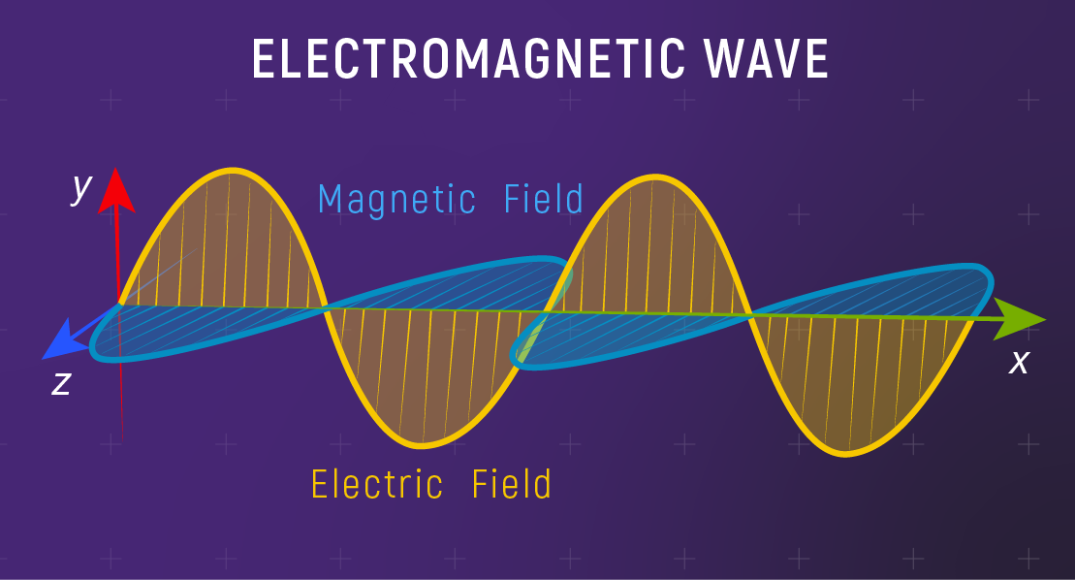
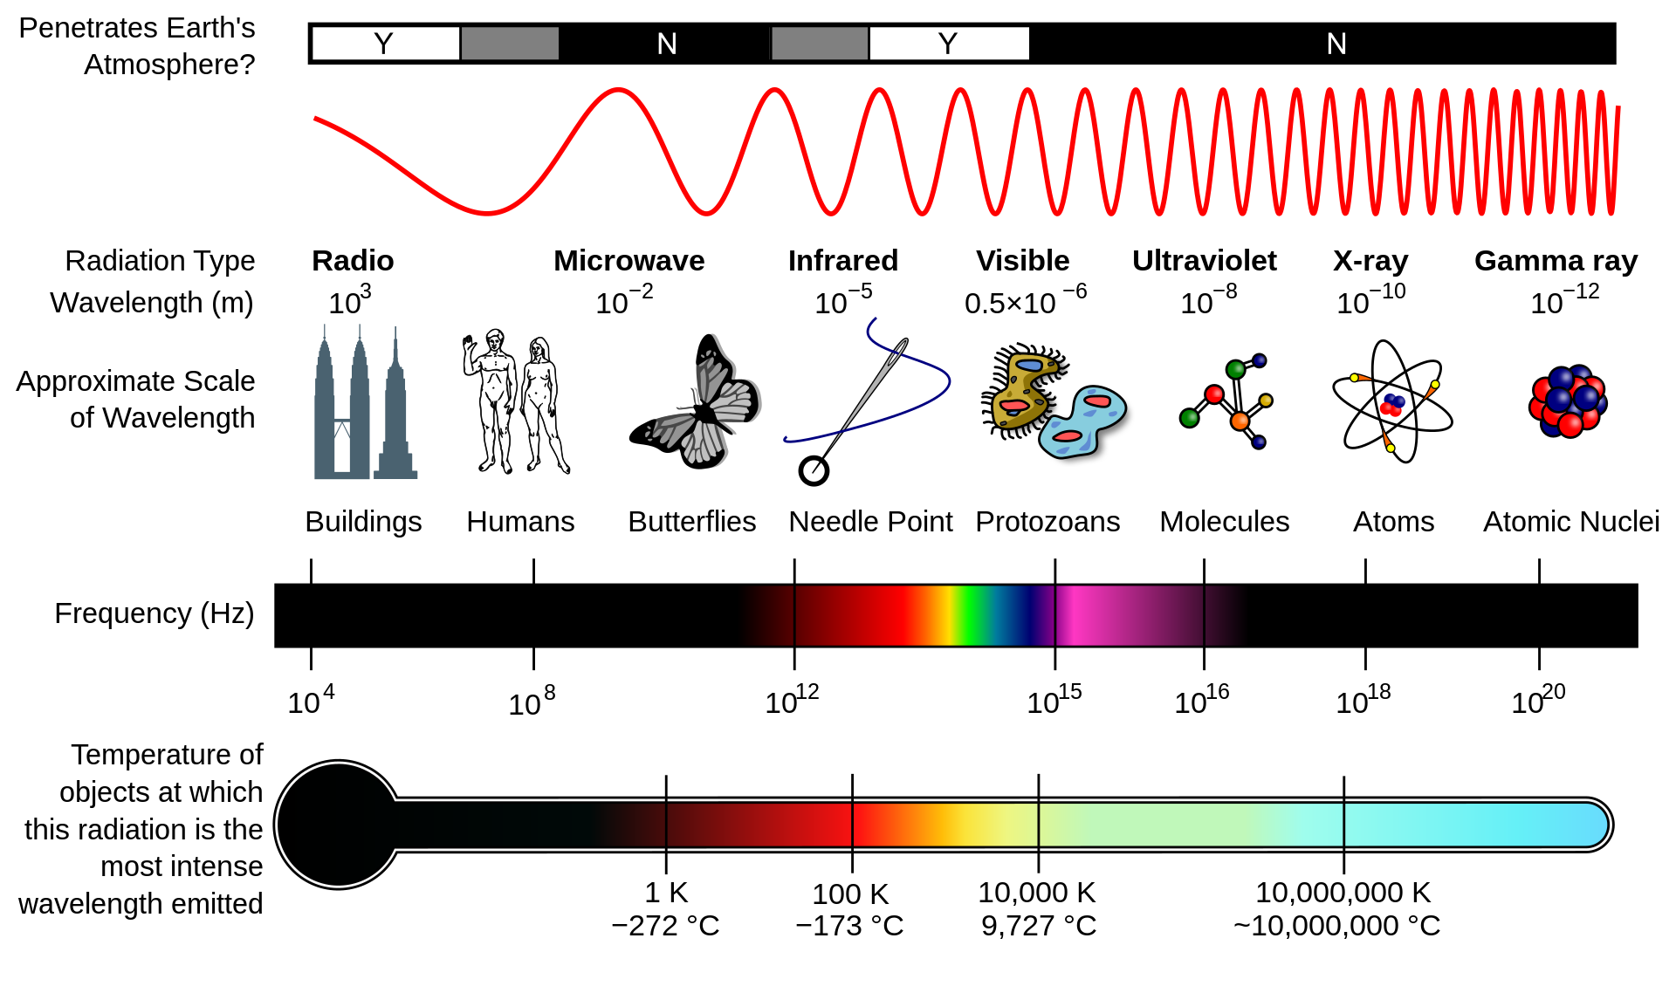
Electromagnetic radiation and spectrum
Electromagnetic waves are synchronized oscillations of electric and magnetic field. There is a periodic change of electric and magnetic field
How often this periodic change occurs dictates the property
Notes:
First, we look at the computational elements, and these consist of a microcontroller or an FPGA. Today, we find that these computational elements consume at least one order of magnitude higher power consumption when compared to the commonly used sensors.
However, we also find that microcontrollers are increasingly becoming energy efficient. We investigate a typical microcontroller that has been used in sensor platforms over the past two decades. We find that energy efficiency has improved by almost two orders of magnitude. Some of the present-generation microcontrollers, such as Ambiq Apollo4 consume just 3 uA/MHz than 330 uA for MSP430 used on platforms such as TelOS B.
If the trend continues, we can expect the microcontrollers to catch up with the sensors and become energy-efficient. This significant improvement is that the digital components are increasing becoming efficient as they follow moore’s law.

Slide 13
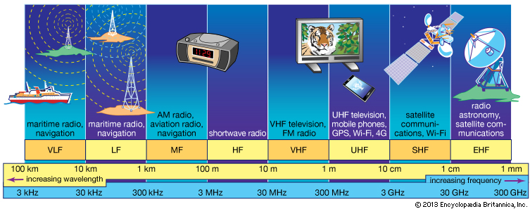
Radio waves are most important part of electromagnetic spectrum
Most (if not all) modern communication relies on radio waves
Frequency range: 30 Hz to 300 GHz
It has the longest wavelength among EM
Notes:
First, we look at the computational elements, and these consist of a microcontroller or an FPGA. Today, we find that these computational elements consume at least one order of magnitude higher power consumption when compared to the commonly used sensors.
However, we also find that microcontrollers are increasingly becoming energy efficient. We investigate a typical microcontroller that has been used in sensor platforms over the past two decades. We find that energy efficiency has improved by almost two orders of magnitude. Some of the present-generation microcontrollers, such as Ambiq Apollo4 consume just 3 uA/MHz than 330 uA for MSP430 used on platforms such as TelOS B.
If the trend continues, we can expect the microcontrollers to catch up with the sensors and become energy-efficient. This significant improvement is that the digital components are increasing becoming efficient as they follow moore’s law.

Slide 14
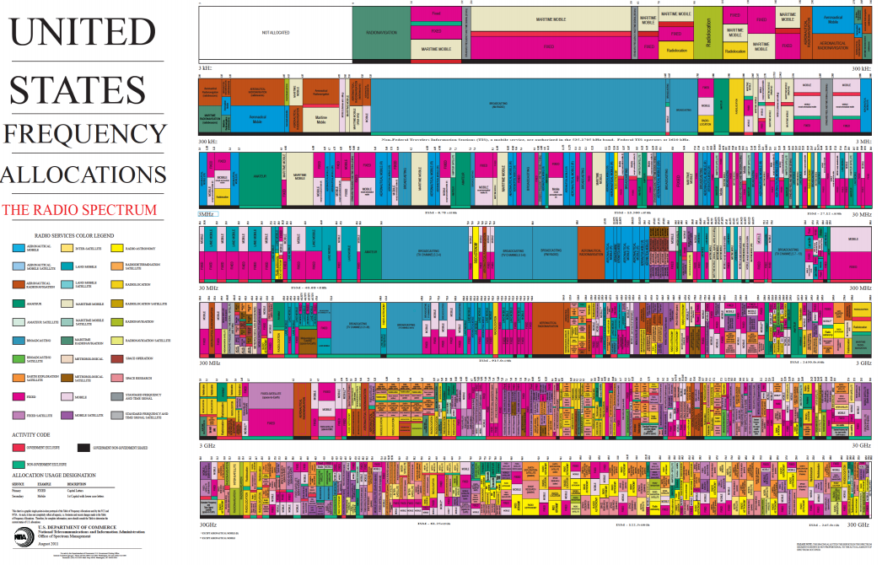
They are allocated for specific use
Notes:
First, we look at the computational elements, and these consist of a microcontroller or an FPGA. Today, we find that these computational elements consume at least one order of magnitude higher power consumption when compared to the commonly used sensors.
However, we also find that microcontrollers are increasingly becoming energy efficient. We investigate a typical microcontroller that has been used in sensor platforms over the past two decades. We find that energy efficiency has improved by almost two orders of magnitude. Some of the present-generation microcontrollers, such as Ambiq Apollo4 consume just 3 uA/MHz than 330 uA for MSP430 used on platforms such as TelOS B.
If the trend continues, we can expect the microcontrollers to catch up with the sensors and become energy-efficient. This significant improvement is that the digital components are increasing becoming efficient as they follow moore’s law.

Slide 15
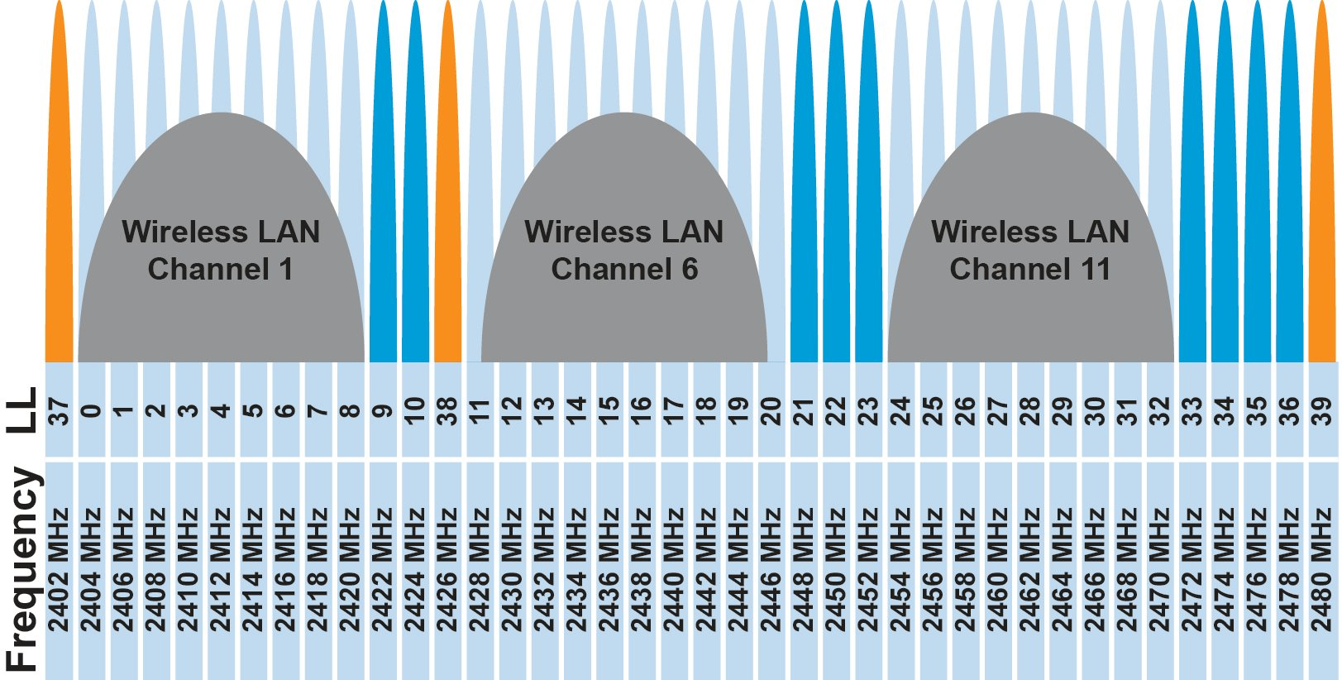
IoT operates in the unlicensed band
902 MHz – 928 MHz
LPWANs
2.4 GHz to 2.5 GHz
WiFi, BLE, Thread
5 GHz
Faster WiFi
Cellular uses licensed bands at great cost
Why?

Slide 16
IoT operates in the unlicensed band
902 MHz – 928 MHz
LPWANs
2.4 GHz to 2.5 GHz
WiFi, BLE, Thread
5 GHz
Faster WiFi
Cellular uses licensed bands at great cost
Why? No interference from other users

Slide 17
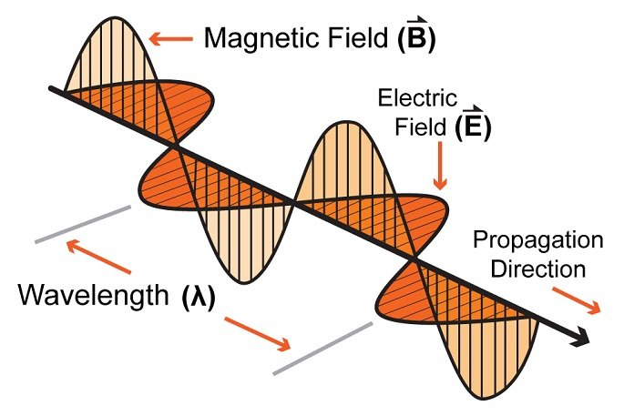
How are radio waves characterized ?
Signal strength
The amount of energy transmitted/received
Signal frequency and bandwidth
Which “channel” the signal is sent on
Signal modulation
How data is encoded in the signal
Notes:
First, we look at the computational elements, and these consist of a microcontroller or an FPGA. Today, we find that these computational elements consume at least one order of magnitude higher power consumption when compared to the commonly used sensors.
However, we also find that microcontrollers are increasingly becoming energy efficient. We investigate a typical microcontroller that has been used in sensor platforms over the past two decades. We find that energy efficiency has improved by almost two orders of magnitude. Some of the present-generation microcontrollers, such as Ambiq Apollo4 consume just 3 uA/MHz than 330 uA for MSP430 used on platforms such as TelOS B.
If the trend continues, we can expect the microcontrollers to catch up with the sensors and become energy-efficient. This significant improvement is that the digital components are increasing becoming efficient as they follow moore’s law.

Slide 18
What are wireless radios?
Radios are electronic devices that enables wireless transmission of signals
Electromagnetic signal is modulated and radiated out of the antenna
Wireless transmissions are then received by a receiver device
Antenna
Radio frequency signal
Radio transmitter
Radio receiver
Notes:
First, we look at the computational elements, and these consist of a microcontroller or an FPGA. Today, we find that these computational elements consume at least one order of magnitude higher power consumption when compared to the commonly used sensors.
However, we also find that microcontrollers are increasingly becoming energy efficient. We investigate a typical microcontroller that has been used in sensor platforms over the past two decades. We find that energy efficiency has improved by almost two orders of magnitude. Some of the present-generation microcontrollers, such as Ambiq Apollo4 consume just 3 uA/MHz than 330 uA for MSP430 used on platforms such as TelOS B.
If the trend continues, we can expect the microcontrollers to catch up with the sensors and become energy-efficient. This significant improvement is that the digital components are increasing becoming efficient as they follow moore’s law.

Slide 19
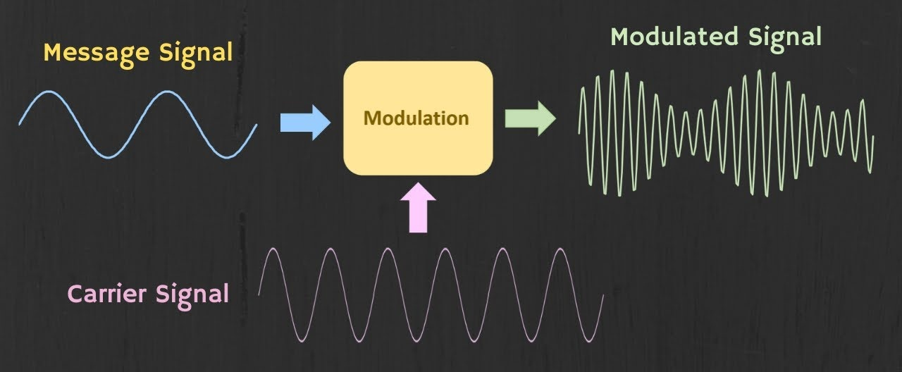
How are radio waves modulated with information ?
Encoding information “baseband" in an analog “carrier” signal
Baseband signal often much lower frequency than carrier
Carrier signal defines the frequency/part of spectrum
Notes:
First, we look at the computational elements, and these consist of a microcontroller or an FPGA. Today, we find that these computational elements consume at least one order of magnitude higher power consumption when compared to the commonly used sensors.
However, we also find that microcontrollers are increasingly becoming energy efficient. We investigate a typical microcontroller that has been used in sensor platforms over the past two decades. We find that energy efficiency has improved by almost two orders of magnitude. Some of the present-generation microcontrollers, such as Ambiq Apollo4 consume just 3 uA/MHz than 330 uA for MSP430 used on platforms such as TelOS B.
If the trend continues, we can expect the microcontrollers to catch up with the sensors and become energy-efficient. This significant improvement is that the digital components are increasing becoming efficient as they follow moore’s law.

Slide 20
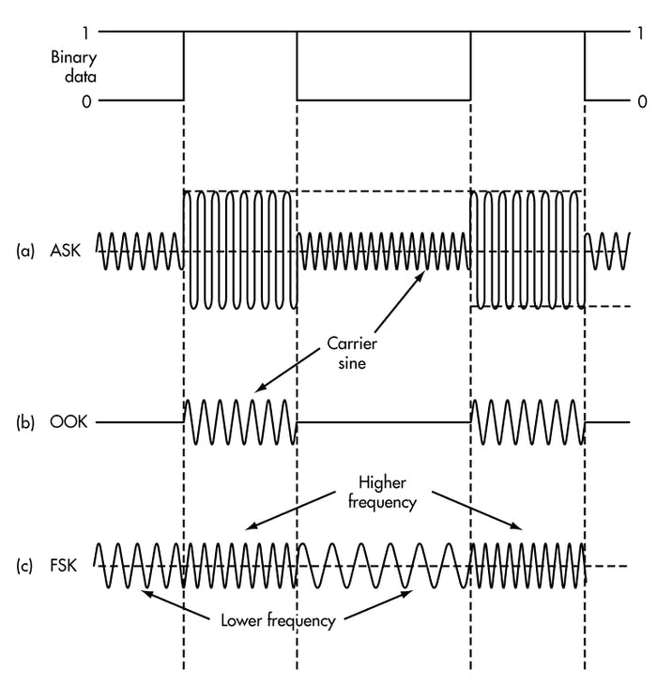
How are radio waves modulated with information
Amplitude-shift Keying (ASK)
Modify amplitude of carrier signal
On-Off Keying (OOK)
Frequency-shift Keying (FSK)
Modify frequency of carrier signal

Slide 21
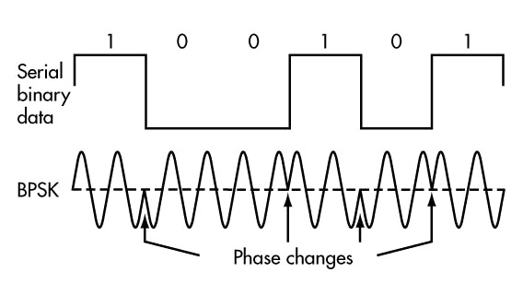
How are radio waves modulated with information
Phase-shift keying (PSK)
Modify phase of carrier signal
Usually differential: the change signifies data
More complicated possibilities exist
QAM (Quadrature Amplitude Modulation) - amplitude and phase shift keying

Slide 22
Break! (5 minutes)
Notes:
++ Over the past few years, I have designed several backscatter and beyond backscatter systems that precisely overcome these critical challenges that have limited the widespread deployment of backscatter on IoT devices.
++ The research vision that I have pursued and would like to pursue as a faculty member is to enable a massive deployment of IoT devices by bridging the energy asymmetry between sensing, computation and communication blocks by designing novel platforms and communication mechanisms. I am going to describe some of my research contributions next.

Slide 23
How many radio standards can you identify ?
Notes:
++ Over the past few years, I have designed several backscatter and beyond backscatter systems that precisely overcome these critical challenges that have limited the widespread deployment of backscatter on IoT devices.
++ The research vision that I have pursued and would like to pursue as a faculty member is to enable a massive deployment of IoT devices by bridging the energy asymmetry between sensing, computation and communication blocks by designing novel platforms and communication mechanisms. I am going to describe some of my research contributions next.

Slide 24
Apple Airpods?
Apple airpods
Notes:
+ I begin this presentation by demonstrating devices that we interact with within our daily lives. These include Fitbit, AirPods, smart speakers or ble proximity beacons that we attach to objects such as keychain to keep track of them. All of these are examples of wireless embedded systems.

Slide 25
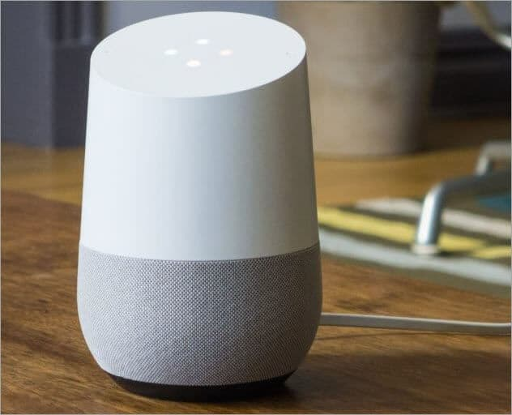
Connected speakers/ smart speakers ?
Smart Speaker
Notes:
+ I begin this presentation by demonstrating devices that we interact with within our daily lives. These include Fitbit, AirPods, smart speakers or ble proximity beacons that we attach to objects such as keychain to keep track of them. All of these are examples of wireless embedded systems.

Slide 26
Characteristics of IoT radio standard
Many radio standards and protocols
Different characteristics to suit varied applications
Short vs. long distance
High vs. low power/energy
High vs. low speeds
Large vs. small number of devices
Indoor vs. outdoor usages
Notes:
First, we look at the computational elements, and these consist of a microcontroller or an FPGA. Today, we find that these computational elements consume at least one order of magnitude higher power consumption when compared to the commonly used sensors.
However, we also find that microcontrollers are increasingly becoming energy efficient. We investigate a typical microcontroller that has been used in sensor platforms over the past two decades. We find that energy efficiency has improved by almost two orders of magnitude. Some of the present-generation microcontrollers, such as Ambiq Apollo4 consume just 3 uA/MHz than 330 uA for MSP430 used on platforms such as TelOS B.
If the trend continues, we can expect the microcontrollers to catch up with the sensors and become energy-efficient. This significant improvement is that the digital components are increasing becoming efficient as they follow moore’s law.

Slide 27
Characteristics of common radio standards for IoT
Indoor applications
Outdoor applications
Requirements
Short range
High data rate
Small number of devices
Common standards
Bluetooth
ZigBee
WiFi
Requirements
Long range
Low data rate
Large number of devices
Common standards
Sigfox/ FSK
Narrow band LTE
LoRa
Notes:
https://www.sparkfun.com/products/10268
http://www.directindustry.com/prod/digi-international/zigbee-radio-modules-16022-799537.html
http://labs.beatcraft.com/en/index.php?gadget%20%2F%20ANT%20module
https://www.sparkfun.com/products/10822

Slide 28
Radio standards for indoor applications
Notes:
++ Over the past few years, I have designed several backscatter and beyond backscatter systems that precisely overcome these critical challenges that have limited the widespread deployment of backscatter on IoT devices.
++ The research vision that I have pursued and would like to pursue as a faculty member is to enable a massive deployment of IoT devices by bridging the energy asymmetry between sensing, computation and communication blocks by designing novel platforms and communication mechanisms. I am going to describe some of my research contributions next.

Slide 29
Characteristics of common radio standards for IoT
Indoor applications
Outdoor applications
Design requirements
Short range
High data rate
Small number of devices
Common radio standards
Bluetooth
ZigBee
WiFi
Design requirements
Long range
Low data rate
Large number of devices
Common radio standards
FSK (Sigfox?)
Narrow band LTE
LoRa
Notes:
https://www.sparkfun.com/products/10268
http://www.directindustry.com/prod/digi-international/zigbee-radio-modules-16022-799537.html
http://labs.beatcraft.com/en/index.php?gadget%20%2F%20ANT%20module
https://www.sparkfun.com/products/10822

Slide 30
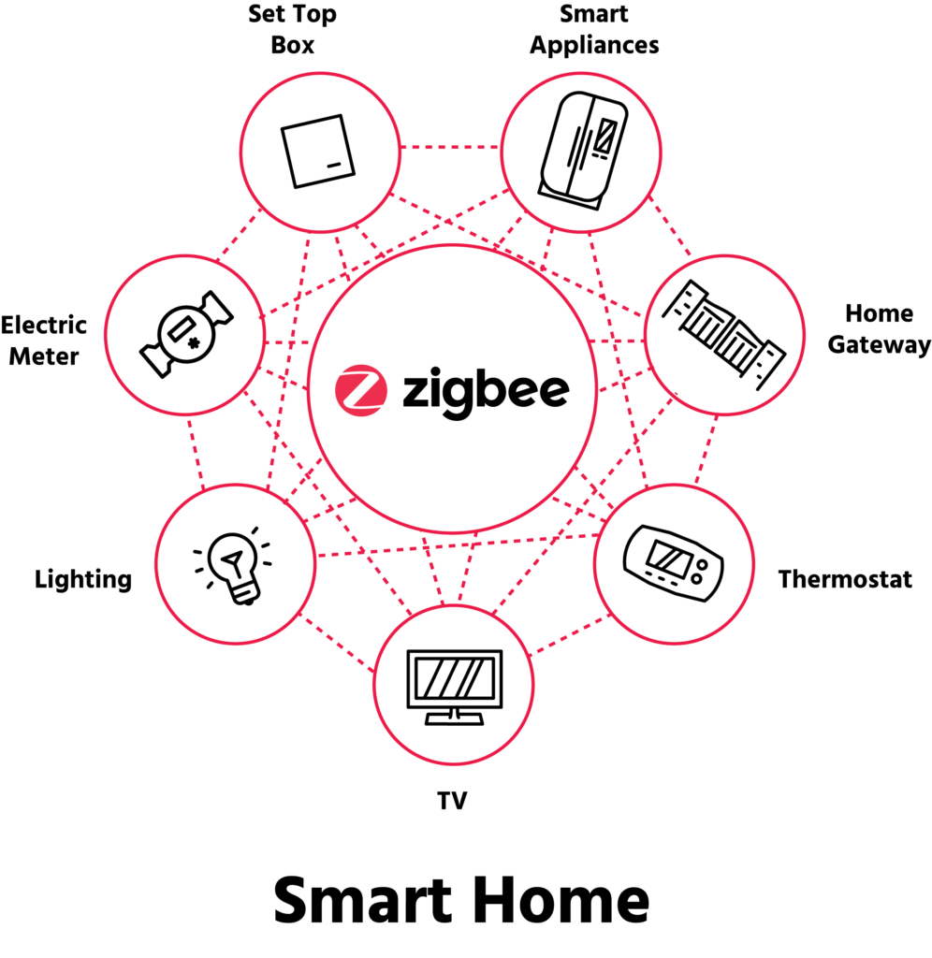
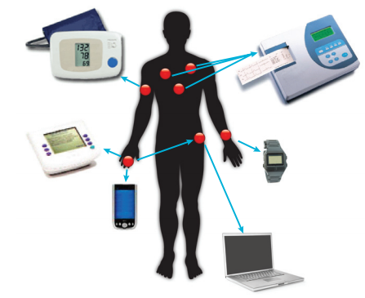
Radio standard : ZigBee
Indoor applications; Focus home and industrial environments
Environmental sensors; Medical devices; Household automation
Low power, low cost and enables communication between devices
Key capability; forming mesh for communication between devices
Notes:
Why do the IoT platforms suffer from this energy challenge? To understand this, we investigate the architecture of the IoT device. We show this architecture in the figure on the slide. It consists of a series of stages that enable us to sense physical phenomena, process and transmit the sensor information through a transceiver such as ZigBee/BLE/LoRa.
This architecture has remained unchanged over the past two decades. We find that during this time, sensors have become exceeding efficient. Today, we find sensors such as an accelerometer or a temperature sensor consumes just a few tens of microwatts of power consumption. However, we find that rest of the architecture components that are shown in red colour remain significantly energy expensive. To understand the reason for this significant energy asymmetry, we look at the following slide.

Slide 31
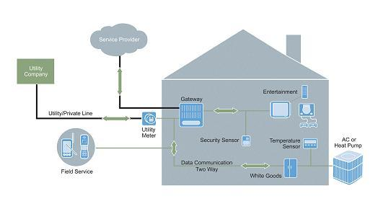
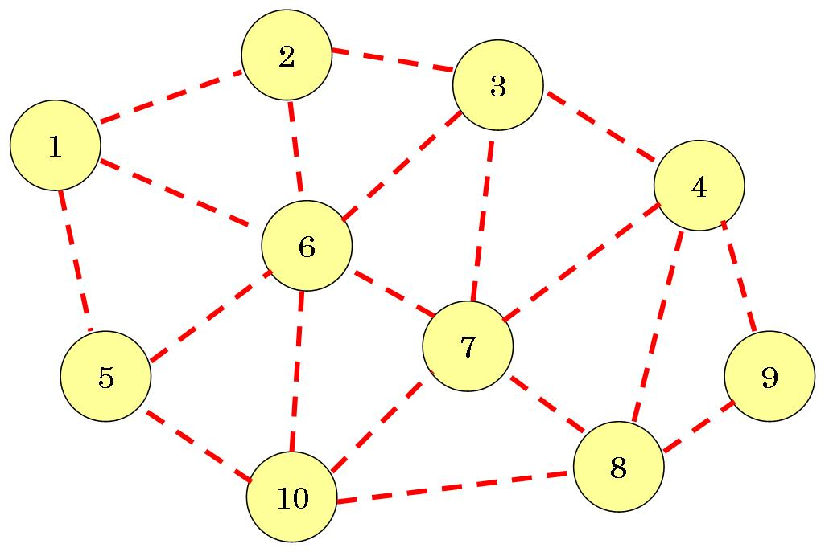
ZigBee devices (usually) operates in a mesh
Mesh consists of many devices. Each device transmits its own data. However, some devices relay other devices sensor data.
Extends transmission range, coverage, and reliability
Multiple paths to destination. Network grows much larger than pont-to-point networks. The mesh is self-healing and self-forming.
Image Source: <http://kf5czo.blogspot.com/2012/03/ham-radio-and-mesh-networks.html>

Slide 32
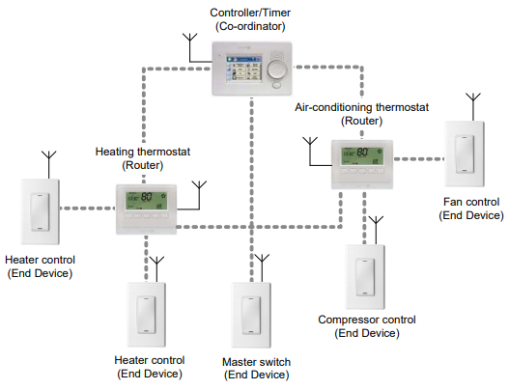
Typical example of a ZigBee deployment
Notes:
Why do the IoT platforms suffer from this energy challenge? To understand this, we investigate the architecture of the IoT device. We show this architecture in the figure on the slide. It consists of a series of stages that enable us to sense physical phenomena, process and transmit the sensor information through a transceiver such as ZigBee/BLE/LoRa.
This architecture has remained unchanged over the past two decades. We find that during this time, sensors have become exceeding efficient. Today, we find sensors such as an accelerometer or a temperature sensor consumes just a few tens of microwatts of power consumption. However, we find that rest of the architecture components that are shown in red colour remain significantly energy expensive. To understand the reason for this significant energy asymmetry, we look at the following slide.

Slide 33
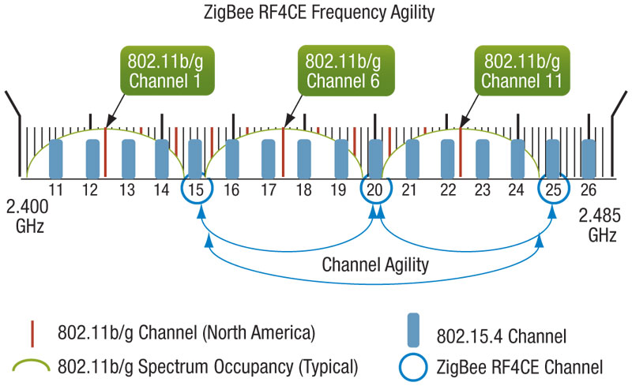
ZigBee radio physical layer characteristics
Operates in 2.4 GHz frequency band. Low power radios.
Zigbee is built on top of 802.15.4
Radio bands: 868MHz in Europe, 915MHz in US and Australia. 2.4GHz else worldwide.
15 Channels, each 5 MHz Wide
QPSK modulation scheme
Low data-rate - 250 kbps, low power – few mW

Slide 34
Radio standard : Bluetooth
Device to Device, short-range, wireless transmissions
Usually between an IoT device and a computer
Smartwatch to phone, phone to computer, etc
Most widely used on consumer wireless devices
Master/Slave paradigm (Outdated notation)
Master is the “Computer” and is in charge of interaction
Slave is the “Device” and has little control over interaction parameters
Bluetooth advertisements: No such paradigm
Notes:
Why do the IoT platforms suffer from this energy challenge? To understand this, we investigate the architecture of the IoT device. We show this architecture in the figure on the slide. It consists of a series of stages that enable us to sense physical phenomena, process and transmit the sensor information through a transceiver such as ZigBee/BLE/LoRa.
This architecture has remained unchanged over the past two decades. We find that during this time, sensors have become exceeding efficient. Today, we find sensors such as an accelerometer or a temperature sensor consumes just a few tens of microwatts of power consumption. However, we find that rest of the architecture components that are shown in red colour remain significantly energy expensive. To understand the reason for this significant energy asymmetry, we look at the following slide.

Slide 35
Bluetooth devices are all around us...
Google nest thermostat
Fitbit activity tracker
Apple airpods
Smart speaker
Ring doorbell
Xiaomi temperature sensor
Philips hue smart bulb
Smart badges
BLE proximity beacon
Notes:
+ I begin this presentation by demonstrating devices that we interact with within our daily lives. These include Fitbit, AirPods, smart speakers or ble proximity beacons that we attach to objects such as keychain to keep track of them. All of these are examples of wireless embedded systems.

Slide 36
Bluetooth network topology
Peripheral
Connection
Central & Scanner
Scanner
Connection
Peripheral
Advertisement
Advertisement
Advertisement
Advertisement
Advertiser
Advertiser
Advertiser

Slide 37
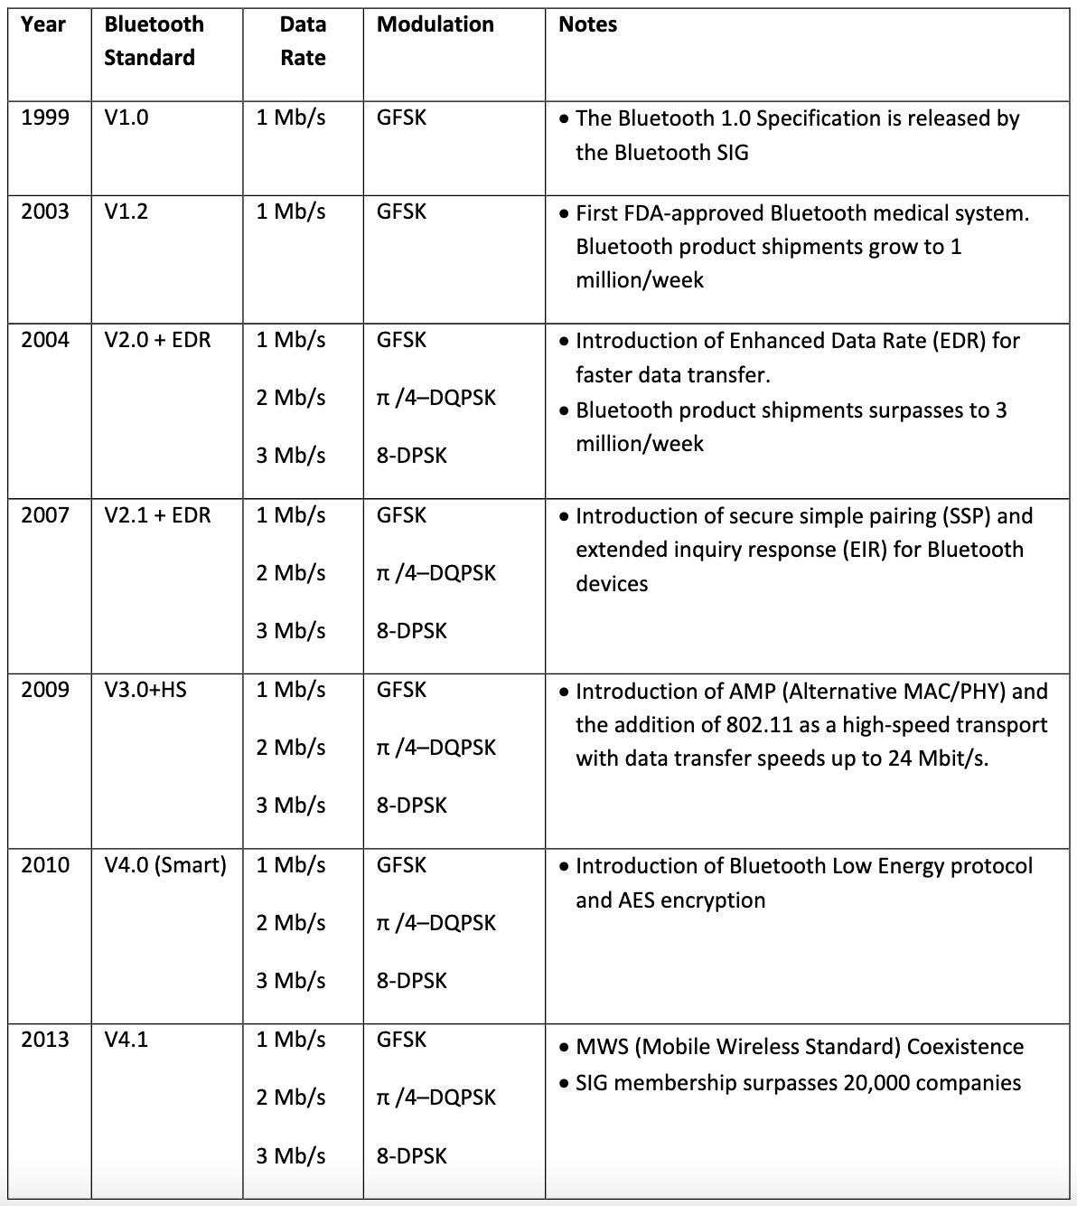
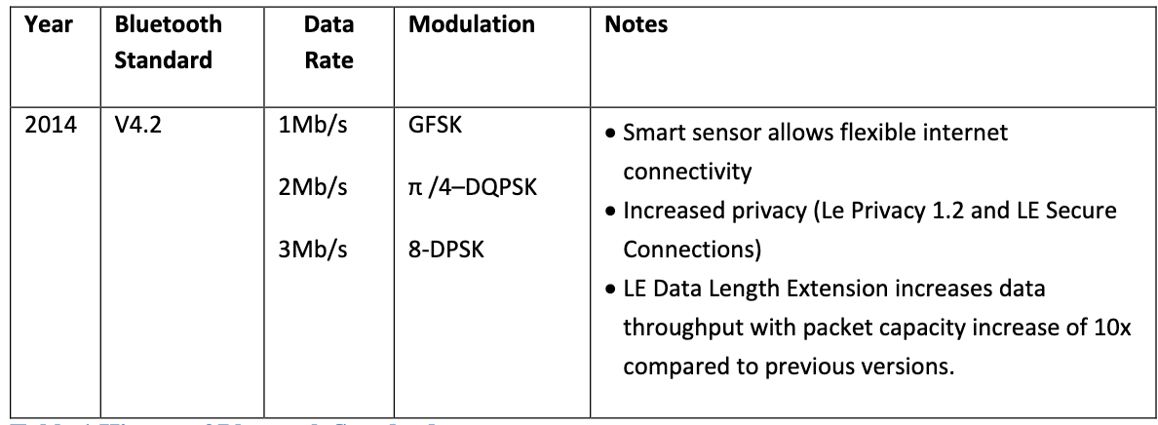
Long history of Bluetooth — the IoT is near-exclusively BLE (Bluetooth 4.0+) as opposed to Bluetooth Classic (<4.0)

Slide 38
Operating frequency of BLE
2.4 GHz carrier, Forty 2-MHz channels, 1 Mbps data rate
37, 38, 39 for advertising, 0-36 for connection (FHSS)
Why doesn’t BLE avoid WiFi altogether?

Slide 39
Operating frequency of BLE
2.4 GHz carrier, Forty 2-MHz channels, 1 Mbps data rate
37, 38, 39 for advertising, 0-36 for connection (FHSS)
Why doesn’t BLE avoid WiFi altogether?
Can’t on 2.4 GHz
Wants 2.4 GHz for technology improvements

Slide 40
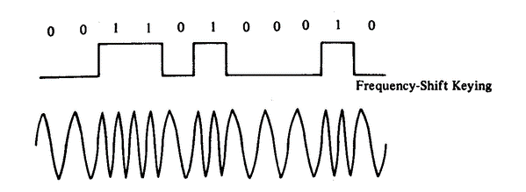
Bluetooth modulation
Gaussian Frequency-Shift Keying (GFSK)
Improvement on base Frequency-shift Keying
Smoother transitions between bits -> reduces nearby interference

Slide 41
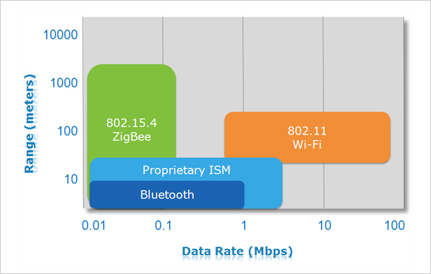
Comparing different radio standards
Notes:
https://www.sparkfun.com/products/10268
http://www.directindustry.com/prod/digi-international/zigbee-radio-modules-16022-799537.html
http://labs.beatcraft.com/en/index.php?gadget%20%2F%20ANT%20module
https://www.sparkfun.com/products/10822

Slide 42
Case study: WiFi and BLE Backscatter
Notes:
++ Over the past few years, I have designed several backscatter and beyond backscatter systems that precisely overcome these critical challenges that have limited the widespread deployment of backscatter on IoT devices.
++ The research vision that I have pursued and would like to pursue as a faculty member is to enable a massive deployment of IoT devices by bridging the energy asymmetry between sensing, computation and communication blocks by designing novel platforms and communication mechanisms. I am going to describe some of my research contributions next.

Slide 43
Backscatter transmits at (up to) 10000x lower power consumption than conventional radios
Backscatter through absorption or reflection of ambient wireless signals enables wireless transmissions at microwatts of power consumption
Ambient RF signal
Antenna
Reflected (backscatter) signal
RF Switch
Modulating Signal (Digital)
Backscatter tag
Receiver
Notes:
Backscatter communication actually help us overcome this limitation

Slide 44
Bluetooth Backscatter
Modulating signal: 2-FSK containing baseband information
Basics of 2-FSK: 1 Represented by frequency f1, 0 represented by frequency f2
Ambient RF signal (2.4 GHz tone)
Antenna
Bluetooth backscatter transmission
Modulating Signal (Bluetooth baseband 2-FSK)
RF Switch
Bluetooth Tag
Smartphone
Notes:
Backscatter communication actually help us overcome this limitation

Slide 45
Generating WiFi transmissions via backscatter
Modulating signal: OQPSK corresponding to WiFi 802.11b standard
Information encoded in phase changes
Ambient RF signal (2.4 GHz tone)
Antenna
Bluetooth backscatter transmission
Modulating Signal (Bluetooth baseband 2-FSK)
RF Switch
Bluetooth Tag
Smartphone
Notes:
Backscatter communication actually help us overcome this limitation

Slide 46

Generating WiFi transmissions via backscatter
Notes:
Backscatter communication actually help us overcome this limitation

Slide 47
Readings for next week (to be submitted)
Passive Wi-Fi: Bringing Low Power to Wi-Fi Transmissions, USENIX NSDI 2016 (Best Paper award)
To be submitted on HotCRP: IoT-Class (should have received invite)
Notes:
Backscatter communication actually help us overcome this limitation

Slide 48
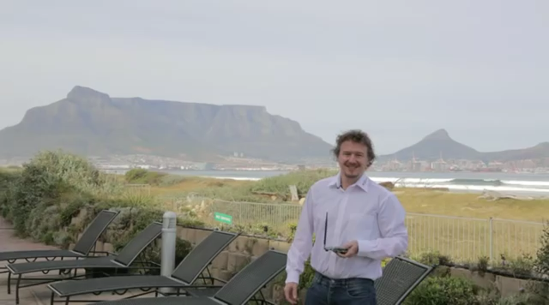
Next week
Deep dive: WiFi, low-Power Long range
Notes:
Backscatter communication actually help us overcome this limitation

Slide 49
Learning objectives for today’s lecture
Major components and tasks of internet of things
History of wireless, and basics of radio waves and communication
Short range wireless standards for Internet of Things
Case study: Backscattering Bluetooth/WiFi compatible signals
Notes:
Why do the IoT platforms suffer from this energy challenge? To understand this, we investigate the architecture of the IoT device. We show this architecture in the figure on the slide. It consists of a series of stages that enable us to sense physical phenomena, process and transmit the sensor information through a transceiver such as ZigBee/BLE/LoRa.
This architecture has remained unchanged over the past two decades. We find that during this time, sensors have become exceeding efficient. Today, we find sensors such as an accelerometer or a temperature sensor consumes just a few tens of microwatts of power consumption. However, we find that rest of the architecture components that are shown in red colour remain significantly energy expensive. To understand the reason for this significant energy asymmetry, we look at the following slide.

Slide 50
CS 6204 - Advanced Topics in Networking
Ambuj Varshney
ambujv@nus.edu.sg
http://ambuj.se
Notes:
Good morning/afternoon everyone. Thank you for inviting me for giving this talk.
In this talk, I will describe my effort to design ubiquitous Internet of Things systems.
In the end of the talk: I will cover some of the future research directions that I would like to address as a faculty member.

